Slide 1



^{NLP PROJECT PRESENTATION}
News Text Classification
Group 5:
Umang Kamdar - AU1841069
Yesha Ajudia - AU1841078
Kartavi Baxi - AU1841079
Jainesh Patel - AU1841101
Hetvi Parekh - AU1900003

Slide 2
Introduction
The project is focused on the development of a classification system, focused on the classification of news articles into a few predefined categories.
This project uses a hybrid model (machine learning-based classification in combination with rule-based classification). It is built upon the concepts of Natural Language Processing.
The developed system tries to assimilate a rule-based approach also, in order to eliminate the flaws, if any, in the model trained by only the machine learning approach.
The project also focuses on optimising the classification-prediction process by developing a system capable of classifying the input more than once by modifying the input through different modules of the system, comparing the different prediction outputs and then, providing the final prediction, based on the coded conditions.

Slide 3
Problem Statement
With the increase in digitization and availability of large amount of data, the need for categorization has become pertinent.
Users prefer to read news articles, blogs, ebooks, etc. on a particular topics of their interest.
Thus, it becomes necessary to sort the content categorically and also provide interest and intent based suggestions to the users.
On the other hand, young writers who venture into free-form writing wish to check that how their pieces can be improved to fit into a categorical classification.
Thus, a robust system is highly required for the task.
Notes:
With the increase in digitization and availability of large amount of data, the need for categorization has become pertinent. Users need news articles, blogs, ebooks, etc. on a particular topics of their interest. Thus, it becomes necessary to sort the content categorically and also provide interest and intent based suggestions to the users. On the other hand, young writers who venture into free-form writing wish to check that how their pieces can be improved to fit into a categorical classification. Thus, a robust system is highly required for the task.

Slide 4

Literature Survey

Slide 5
Steps for Classification
Text Preprocessing
A vital stage in text classification particularly and text mining generally.
Done by text documents collection, tokenization, stop-words removal, and stemming [2].
Data collection, pre-processing, feature selection, classification techniques application, and evaluating performance measures [1].
Frequency Distribution
The frequency distribution of every unigram and bi-gram gives the idea about the frequent words appearing in all categories [3].
Feature Vectorization
Bag of Words just creates a set of vectors containing the count of word occurrences in the document, while the TF-IDF model contains information on the more important words and the less important ones as well.
Bag of Words vectors are easy to interpret. However, TF-IDF usually performs better in machine learning models [4].

Slide 6
Classification Algorithms
Naive Bayes Classifier
Simple probabilistic classifier which works on the assumption of conditional independence between the features of a text document [5], which is the so-called “Naive Bayes assumption” [7].
Successfully applied to document classification in many research efforts [7].
Found to be superior, when compared to the state-of-the-art algorithms for decision tree induction, instance-based learning, and rule induction on standard benchmark datasets, even on datasets with substantial feature dependencies [10].
It is based on the Bayes rule. Naive Bayes classifies the document to the class which maximizes the posterior probability [5].
All the classification algorithms have their own pros and cons [5].
Machine learning techniques that have been actively explored for text classification include Naive Bayes classifier, K-nearest neighbor classifiers, support vector machine, neural networks [6].
Naive Bayes Models
Mainly two models: the Multivariate Bernoulli Model and the Multinomial Model [8].
The Multivariate model has binary representation of features while the later represents the features with term frequency [5].
It was observed in [9] that Multinomial Naive Bayes performs better than Multivariate Bernoulli Naive Bayes. Multinomial Naive Bayes event model is more suitable when the dataset is large when compared to the Multivariate Bernoulli Naive Bayes Model [11].

Slide 7
Dataset
This is a reusable publicly-available dataset for “media bias” studies. The content of this dataset is publish date, title, subtitle and text for 3824 news articles.
The source of these news articles are from ABC News, CNN news, The Huffington Post, BBC News, DW News, TASS News, Al Jazeera News, China Daily and RTE News.
The articles which fall under the categories that did not have enough number of samples, were removed from the dataset and the categories of the remaining samples were defined.
Now the category distribution was uneven, which might have led to misclassification. So, we added some samples from the publicly available BBC News dataset, which had different articles than those covered in the existing dataset.
Hence, now we have total 2509 samples in the dataset, which fall under five categories namely, politics, sports, entertainment, business, and tech.

Slide 8
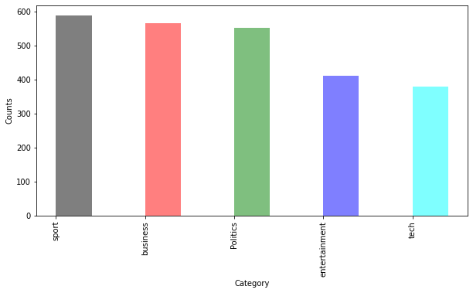
Data Balance
Balance in the dataset

Slide 9
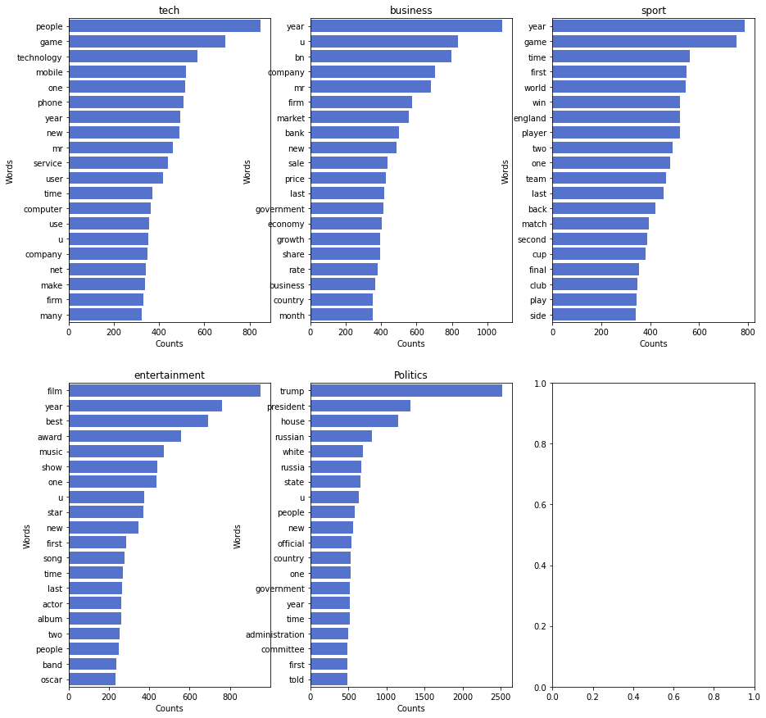
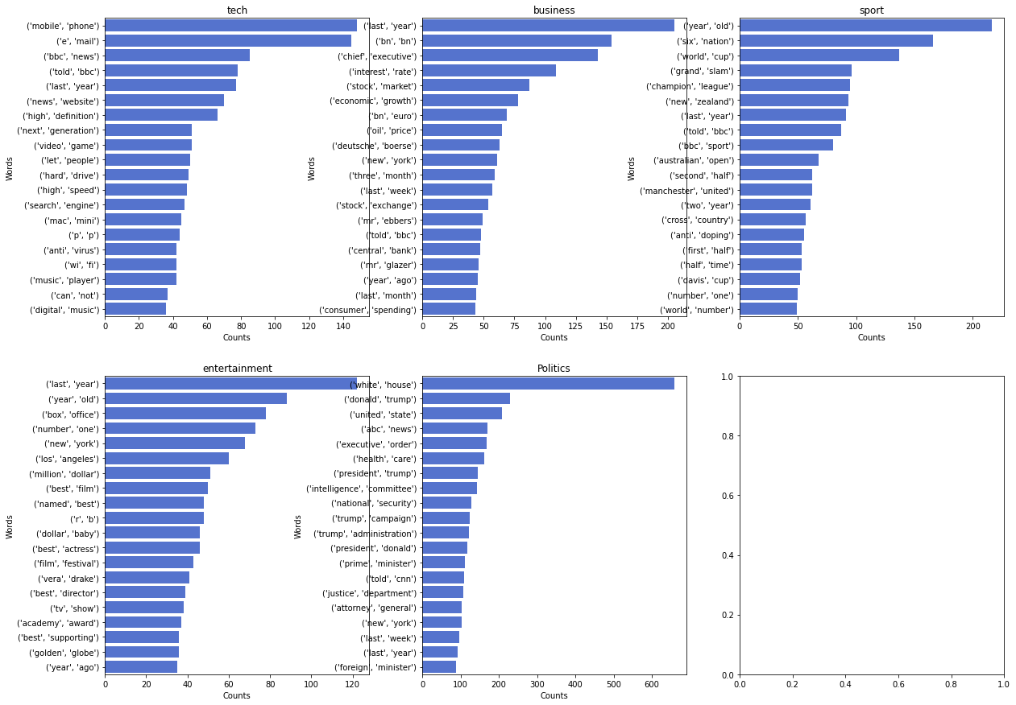
Data Visualization
Unigram Frequency Distribution
Bigram Frequency Distribution

Slide 10

Modules Implemented
Classification Model
Prediction on input data (using Threshold)
Summarization
Prediction on Summary (using Threshold)
Rule based Comparison for Final Prediction

Slide 11
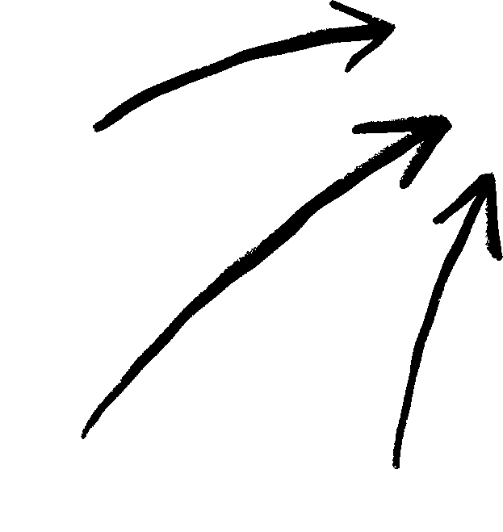
Architecture
CLASSIFICATION MODEL
PREDICTION ON INPUT DATA
SUMMARIZATION
PREDICTION ON SUMMARY
FINAL PREDICTION
Data Cleaning and Preprocessing
Take input from user
Sentence Tokenization
Processing summary
Comparing both the predictions
Data Visualization
Prediction based on threshold
Generate Final Prediction based on rules defined
Processing input
Input Cleaning and Preprocessing
Label Encoding
Prediction based on threshold
Weighted word frequency
Feature Extraction
Multinomial Naive Bayes Classification
Sentence score
= Processing
Accuracy on Test data
Generate Summary

Slide 12
Classification Model
DATA IMPORTING, CLEANING & PREPROCESSING
LABEL ENCODING
FEATURE EXTRACTION
FIT CLASSIFICATION MODEL
PREDICTION OF USER INPUT
Data appending
Encoding the categories
Vectorization - Tf-Idf
Multinomial NB classifier
User input
Data balancing
Model fit
Conversion into data frame
Train-test split
n-grams
Extra characters removal
Classification report
Input data cleaning
Case change
Accuracy - Confusion Matrix
Input transform
Stop words removal
Thresholding
Lemmatization
Output

Slide 13
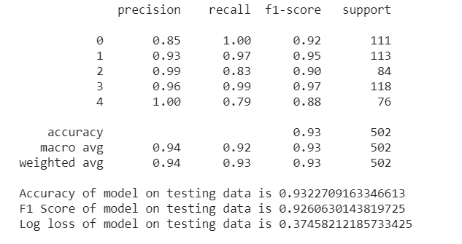
Results
After training the model with train data and testing the model with the test data, accuracy of around 93% was achieved by employing Confusion Matrix.
The perfect precision score was achieved for category 4 (Tech) and a perfect recall score was achieved for category 0 (Politics).
However, the highest f1-score was achieved for category 3 (Sport).
One possible reason for better accuracy for the sport category could be that the highest number of articles belonging to the sport category were present in the dataset.
0: 'Politics', 1: 'business', 2: 'entertainment', 3: 'sport', 4: 'tech'

Slide 14
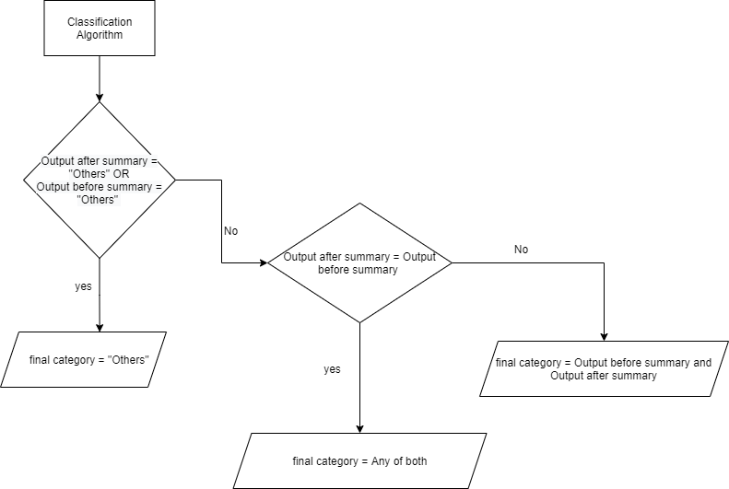
Rule Defining

Slide 15
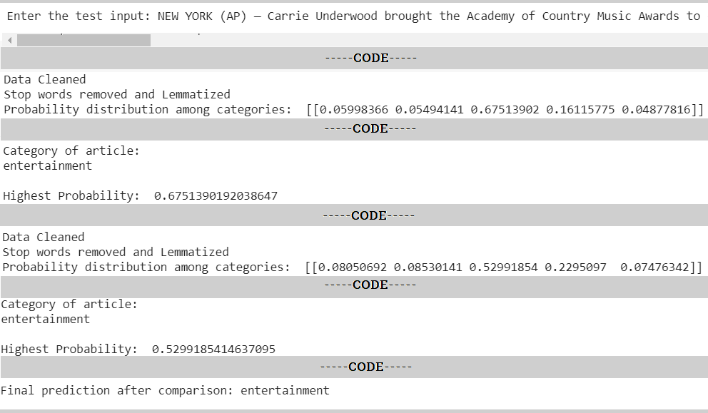
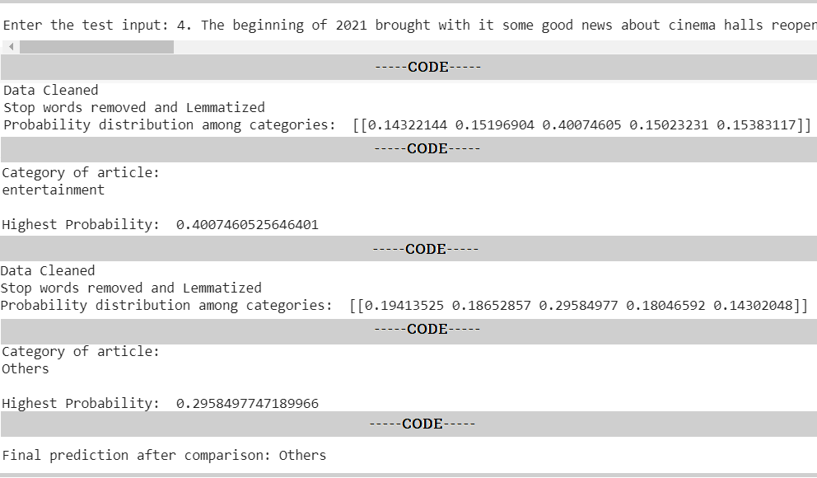
Output
Eg. 1: When both predictions result into same category
Eg. 2: When one of the predictions belongs to “Others” category

Slide 16
Our findings align with the existing literature. Multinomial Naive Bayes and TF-IDF seem the most appropriate method for the classification of news articles.
01
Moreover, as seen, the prediction might differ after the article is reduced into the summary; leaving only the core elements.
02
Conclusion
Hence, taking into consideration the output from two processes seems a better way to optimise the classification programme.
03
04
Thus, this is a hybrid model: machine learning-based and rule-based.

Slide 17

Work Distribution
TASKS
Umang Kamdar
Yesha Ajudia
Kartavi Baxi
Jainesh Patel
Hetvi Parekh
Data Collection & Preprocessing | ✓ | ✓ | ✓ | ✓ | ✓
Literature Review | ✓ | ✓ | ✓ | ✓ | ✓
Classification model | ✓ | ✓ | ✓ | ✓ | ✓
Summarization | ✓ | ✓ | ✓ | ✓ | ✓
Final Prediction | ✓ | ✓ | ✓ | ✓ | ✓
Report | ✓ | ✓ | ✓ | ✓ | ✓

Slide 18
[1] Kaur, Gurmeet, and Karan Bajaj. "News classification and its techniques: a review." IOSR Journal of Computer Engineering (IOSR-JCE) 18.1 (2016): 22-26.
[2] Kadhim, Ammar Ismael. ”An Evaluation of Preprocessing Techniques for Text Classification.” International Journal of Computer Science and Information Security 16.6 (2018).
[3] McNamee, P., Mayfield, J. Character N-Gram Tokenization for European Language Text Retrieval. Information Retrieval 7, 73–97 (2004).
[4] Text, Q. and Huilgol, P., 2021. BoW Model and TF-IDF For Creating Feature From Text. [online] Analytics Vidhya. Available at: https://www.analyticsvidhya.com/blog/2020/02/quick-introduction-bag-of-words-bow-tf-idf/¿
[5] Vijayan, Vikas K., K. R. Bindu, and Latha Parameswaran. "A comprehensive study of text classification algorithms." 2017 International Conference on Advances in Computing, Communications and Informatics (ICACCI). IEEE, 2017.
[6] Patra, Anuradha, and Divakar Singh. "A survey report on text classification with different term weighing methods and comparison between classification algorithms." International Journal of Computer Applications 75.7 (2013).
[7] McCallum, Andrew, and Kamal Nigam. ”A comparison of event models for naive bayes text classification.” AAAI-98 workshop on learning for text categorization. Vol. 752. No. 1. 1998.
[8] Aggarwal, Charu C., and ChengXiang Zhai. "A survey of text classification algorithms." Mining text data. Springer, Boston, MA, 2012. 163-222.
[9] Singh, Gurinder, et al. "Comparison between multinomial and Bernoulli Naive Bayes for text classification." 2019 International Conference on Automation, Computational and Technology Management (ICACTM). IEEE, 2019.
[10] Domingos, Pedro, and Michael Pazzani. "On the optimality of the simple Bayesian classifier under zero-one loss." Machine learning 29.2 (1997): 103-130.
[11] ghila, G. ”A Survey of Naive Bayes Machine Learning approach in Text Document Classification.” arXiv preprint arXiv:1003.1795 (2010).
References

Slide 19

Thank you!

